Slide 1
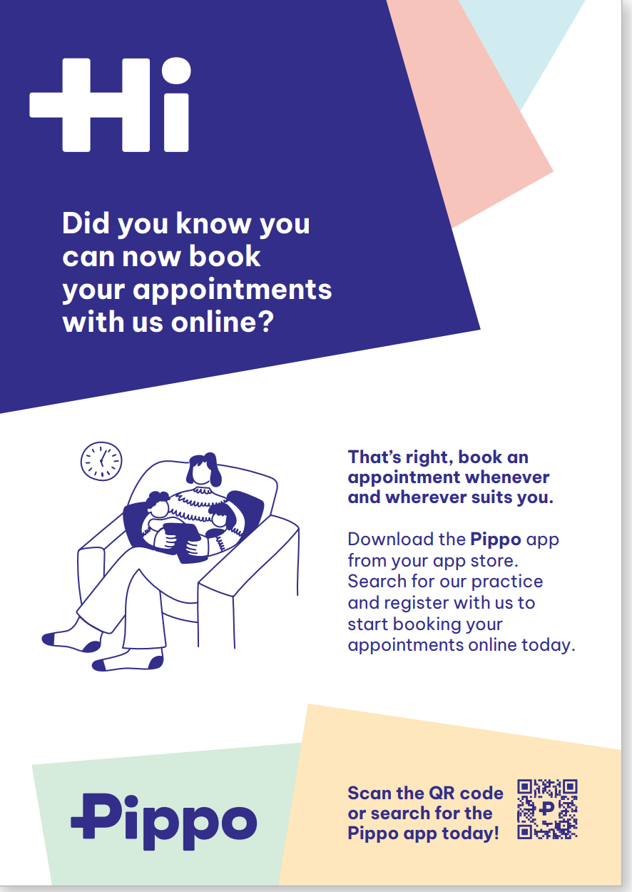




Pippo – Your
Guide to Spreading the News
A new way to book your GP appointments
Wren Fernandes
Customer Success Executive, Clanwilliam Health

Slide 2

Purpose of this Deck
We want to ensure that you’re ready for anything and have everything you need to share Pippo with your patients.
We want your patients to know about Pippo! And how better than some amazing visuals for your practice.
In this deck you’ll find every piece of collateral you need for your practice and a guide on how to use each piece.

Slide 3
What You’ll Find
We want you to be informed! Here’s a list of all the assets you’ll find in this deck:
Posters
Leaflets
Business Cards
Waiting Room Info Slide
Social Media Templates
A Pippo Badge for your website
Branded receipts, letter and email templates
A brand new phone message
Remember, if you are having trouble with any of this you can contact me at wren.fernandes@clanwilliamhealth.com and I will assist you with it.

Slide 4
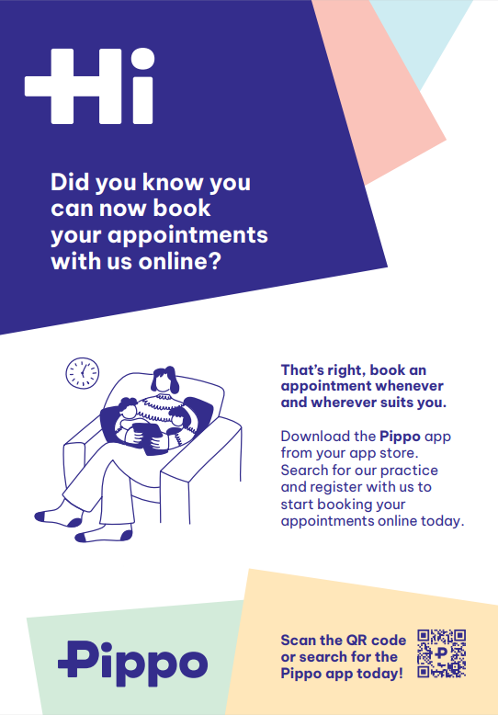

Posters
In your pack you will find a poster template that has all the information your patients need to download the app.
With a custom QR code for your patients to easily scan it can’t get any easier. Simply scan it and they will be taken to their dedicated app store. Download. Sign up. Good to go!
Our recommended print size is 24x36 inches or 18x24 inches depending on the space you have available.

Slide 5
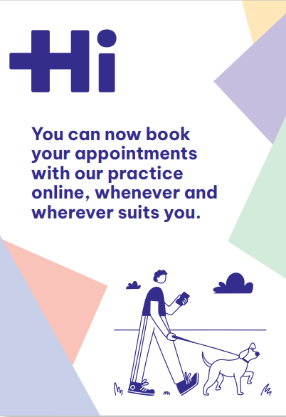
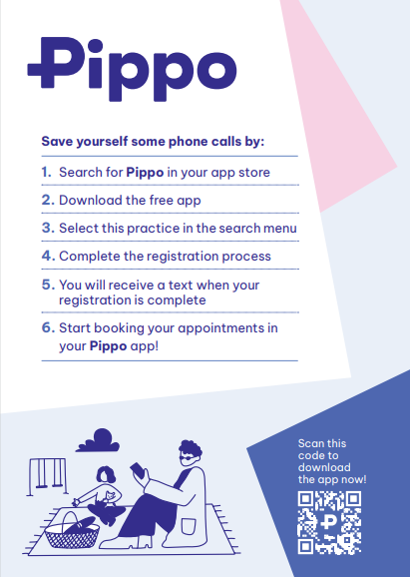
Leaflets
In your pack you will find a leaflet template that has any information your patients need in order to download Pippo in an easy to read, take home format.
The custom QR code is on this design too. Simply scan it and they will be taken to their dedicated app store to download the app. There’s also a step-by-step instruction on how you can download the app.
Our recommended print size is A5 and to be printed on both sides.

Slide 6




Business Cards
In your pack you will find a template for business cards. These should be available for your patients to pick up as they enter/leave your practice.
They’re handy for something small to pick up and slot in your pocket. Think of it as a pocket-size infographic for patients to avail of.

Slide 7

Waiting Room Slide
Do you have a screen in your practice? If so, we have the perfect thing for you. A video infographic for you to display on your screen.
As patients wait for their appointment we want to deliver valuable information to them.
If you already have a screen with infographics running all you have to do is add this template into the mix.
We will provide this to you in both .ppt and in .mp4 format.

Slide 8
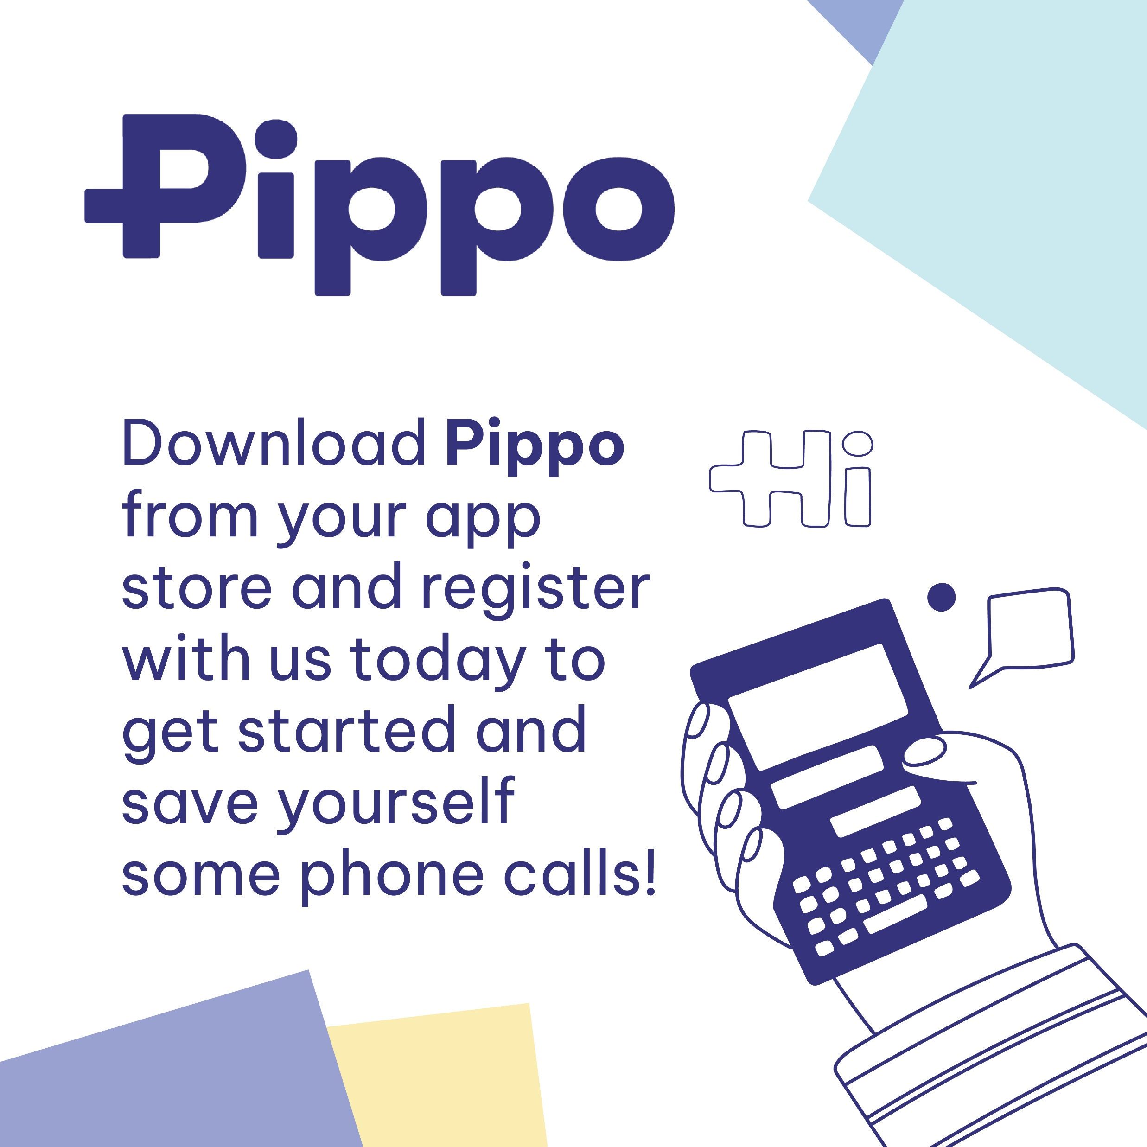
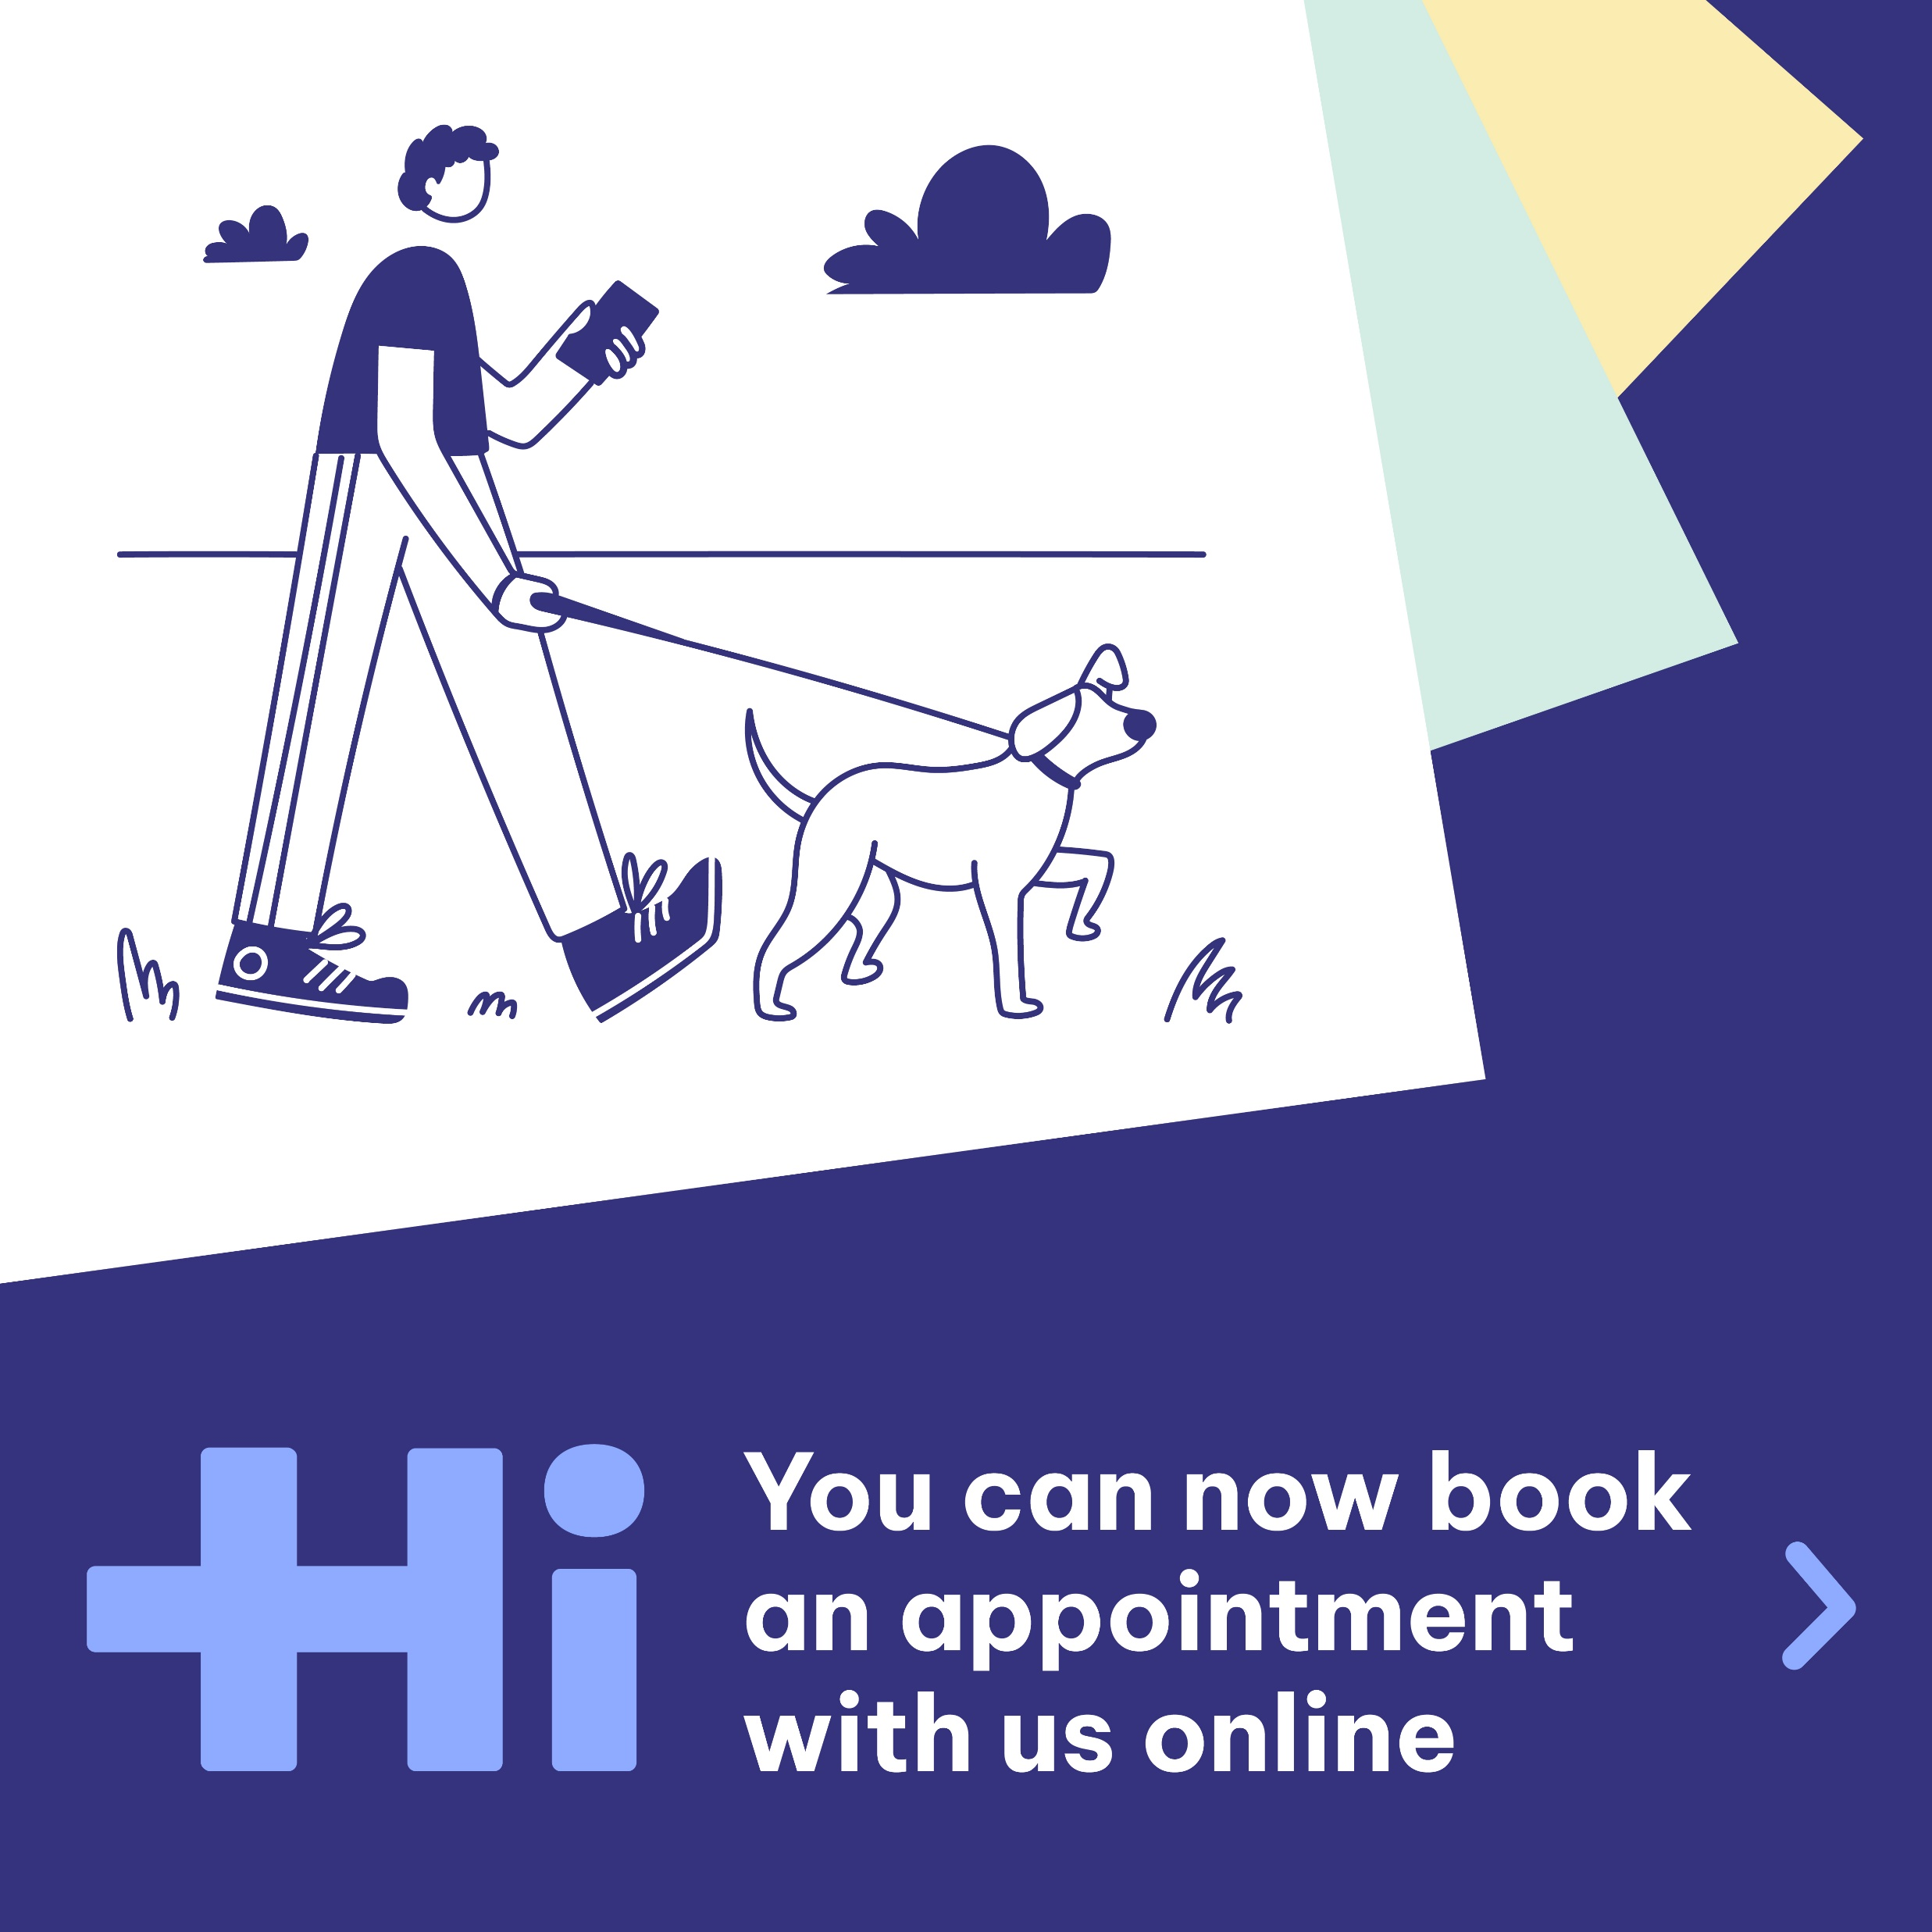

Social Media
In your pack you will find several templates for social media posts. We love to see some Pippo Pride!
Throw these up on your socials to let your patients know you’re registered with Pippo and that booking appointments have never been easier!
No filters, no crop necessary. It’s as easy as selecting the image and hitting upload.
As new features/developments become available we’ll send you new social posts for your own channels.

Slide 9
Pippo Web Badge
In your pack you will find a badge template for your website. This is another way to see some Pippo Pride!
By having the badge you’re showing visitors that you are registered with Pippo and offer an easy appointment booking solution for patients.

Slide 10
Pippo Template
…

